Slide 1

Semantic Tableaux in Propositional Logic
A semantic tableau is a tree representing all the ways the
conjunction of the formulas at the root can be true.
We expand the formulas based on the structure of the
compound formulas. This expansion forms a tree.
If all branches in the tableau lead to a contradiction, then
there is no way the conjunction of the formulas at the root can be true.

Slide 2
Semantic Tableaux in Propositional Logic
A path of the tree represents the conjunction of the formulas along the path.
Semantic tableaux was invented by E.W. Beth and J. Hintikka (1965).

Slide 3
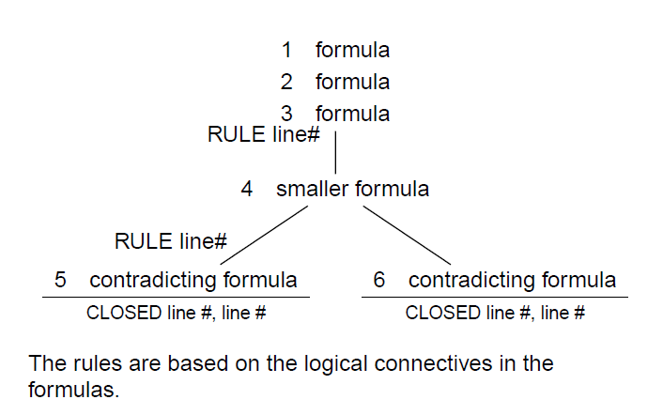
General Form of Tableaux

Slide 4
Semantic Tableaux
A branch is closed is a and ~a both appear on the path from the root of the tree to the leaf of the branch (i.e., there is a contradiction on the branch).
If all branches of the tree are closed, then the tableau is
closed and we can conclude the conjunction of the
formulas at the root are not satisfiable, therefore the
set of formulas is inconsistent.

Slide 5
Semantic Tableaux
We will number all the formulas in the tableau, and use these along with rules to justify the expansion of the tableau. (The order that formulas get assigned numbers doesn’t matter, as long as each formula has a unique number.)

Slide 6
Showing Inconsistency
If all branches of a tableau are closed, the set of formulas at the root are inconsistent.
We can use semantic tableaux to show a set of formulas is inconsistent.

Slide 7
Showing Validity
An argument is valid, if the premises are true then the conclusion must be true.
For an argument to be invalid, there has to be a way for the premises to be true and the conclusion to be false.
To show an argument is valid, we put the premises and the negation of the conclusion at the root of a tableau.
If we can close all the branches of the tableau, then this set of formulas is inconsistent.

Slide 8
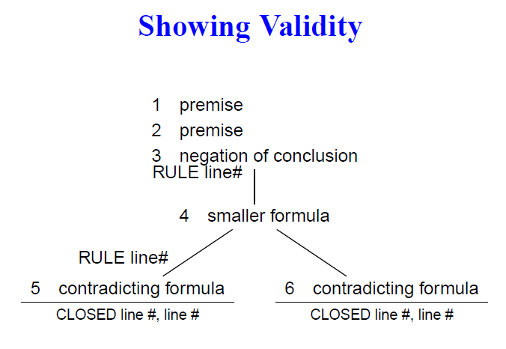
Showing Validity
Alka Singh AI Unit 03

Slide 9
Showing Validity
Semantic tableaux is based on the idea of proof by contradiction. It is a refutation-based system.
Semantic tableaux is a form of backward proof because we start from the conclusion and decompose it and the premises into to smaller and smaller parts until we reach a contradiction.

Slide 10
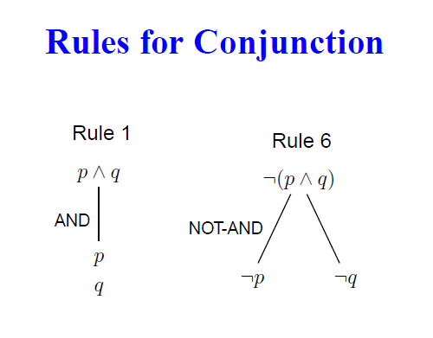
Semantic Tableaux Validity Rules

Slide 11
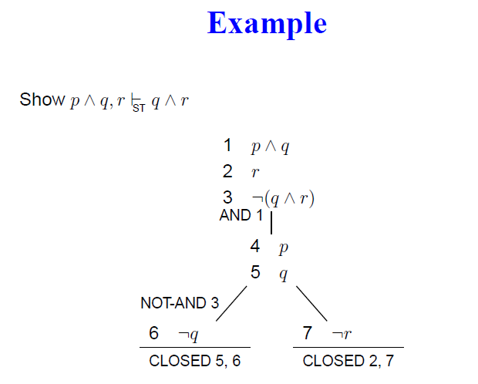
Semantic Tableaux

Slide 12
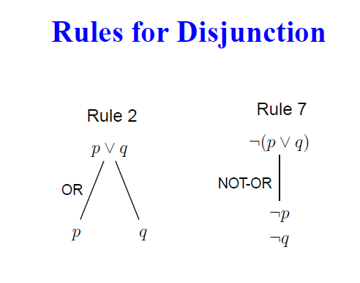
Semantic Tableaux Validity Rules

Slide 13
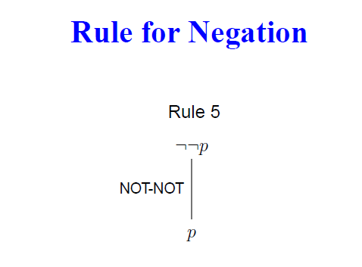
Semantic Tableaux Validity Rules

Slide 14
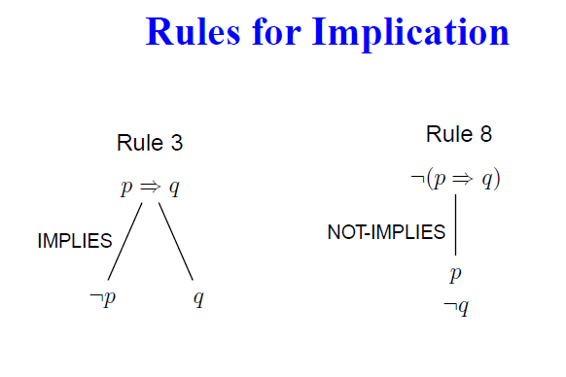
Semantic Tableaux Validity Rules

Slide 15
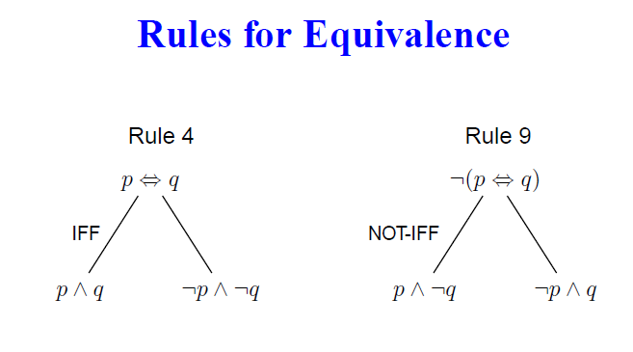
Semantic Tableaux Validity Rules

Slide 16
Example
B | C | D | B->C | DvC | B<->~D | ~(B&C)
T | T | T | T | T | F | F
F | T | T | T | T | T | T
T | F | T | F | T | F | T
F | F | T | T | T | T | T
T | T | F | T | T | T | F
F | T | F | T | T | F | T
T | F | F | F | F | T | T
F | F | F | T | F | F | T

Slide 17
Semantic Tableaux Method
Setup counter example: stack premises and negate conclusion.
Apply rule: stacking first
Check for contradiction: close contradicting branch
Read the answer: All closed = valid, Even one open = Invalid

Slide 18
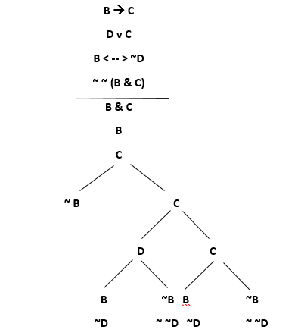
Example

Slide 19
Resolution In Propositional Logic
Resolution refutation is another simple method to prove a formula by contradiction where negation of goal to be proved is added to given set of clauses and shown that there is a refutation in new set using resolution principle.
Clause is a special type of formula which is expressed using {v,~} operators.
During resolution we need to identify two clauses, one with positive atom(P) and other with negative atom(~P) for the application of resolution rule which is based on modus ponen inference rule.

Slide 20
Resolution In Propositional Logic
Resolution method is most favored for developing computer based theorem provers.
Automatic theorem provers using resolution are simple and efficient systems.
This approach is efficient as compared to natural deduction.

Slide 21
Conjunctive and Disjunctive Normal Forms
A formula is in its normal form if it is constructed using only natural connectives {~,v,ꓥ}.
A literal is simply an atom (positive atom) or negation of an atom (negative atom).
A formula of the form L1 v …..v Ln is called disjunction of literals and a formula of the form L1 ꓥ…… ꓥ Ln is called conjunction of literals.

Slide 22
Conjunctive and Disjunctive Normal Forms
In Disjunctive Normal Form (DNF), a formula is represented in the form (L1 ꓥ ….. ꓥ Ln) v……v(Li ꓥ ……. ꓥ Lm) where all L’s are literals. The Disjunctive Normal Form is disjunction of conjunction.
Conjunctive Normal Form (CNF) is conjunction of disjunction. The formula is represented in the form (L1 v ….. v Ln) ꓥ …… ꓥ(Li v…….v Lm), where all L’s are literals.

Slide 23
Conversion of a Formula to its CNF
The following steps are involved for converting a given formula into its CNF representation by using equivalence laws:
Eliminate -- > and < -- > by using following equivalence laws.
P -- > Q = ~P v Q
P < -- > Q = (P -- > Q) ꓥ (Q -- > P)
= (~P v Q) ꓥ (~Q v P)
2. Eliminate double negation signs by using ~~P = P

Slide 24
Conversion of a Formula to its CNF
3. Use De Morgan’s law to push ~(negation) immediately before atomic formula.
~(P ꓥ Q) = ~P v ~Q
~(P v Q) = ~P ꓥ ~Q
4. Use distributive law to get CNF
P v (Q ꓥ R) = (P v Q) ꓥ (P v R)

Slide 25
Clause in Resolution
A clause is a special formula expressed as disjunction of literals. If a clause contains only one literal, then it is called unit clause.
A CNF representation of a formula is of the form (C1 ꓥ C2 ꓥ…… ꓥCn), where each C’s is a clause.

Slide 26
Resolvent Of Clause
If two clauses C1 and C2 contain a complementary pair of literals {L,~L}, then these clauses may be resolved together by deleting L from C1 and ~L from C2 and a new clause is constructed by the disjunction of the remaining literals in C1 and C2.
The new clause thus generated is called resolvent of C1 and C2.

Slide 27
Resolvent Of Clause
While resolving two clauses(parents), only one pair of complementary literals are resolved and remaining literals of both the parents are combined with disjunction operator.
If the resolvent contains one or more pair of complementary literals, then the resolvent automatically becomes true.
Eg. If resolvent of two clauses is R = P v ~P v C, where C is remaining clause, then R = true v C = True.

Slide 28
Resolvent Of Clause
Eg. Consider two clauses
C1 = P v Q v ~R
C2 = ~Q v W
P v Q v ~R ~Q v W
P v ~R v W
Thus, resolvent(P v Q v ~R, ~Q v W) = P v ~R v W

Slide 29
Algorithm for Resolution
To prove: KB |= x
Disapprove: KB,~x
Algorithm
Convert KB to the CNF form
Apply iteratively the resolution rule starting from KB, ~x(in CNF form)
Stop When:-

Slide 30
Algorithm for Resolution
Contradiction (empty clause) is reached: A, ~A -> Ø
Proves entailment
ii. No more new sentences can be derived
Disproves it

Slide 31
Resolution Example
KB: [P -- > Q, Q --> R ꓥ S]
KB in CNF: [~P v Q , ~Q v R , ~Q v S]
Resolve KB(1) & KB(2) producing: ~P v R (i.e, P -- > R)
Resolve KB(1) & KB(3) producing: ~P v S (i.e, P -- > S)
New KB: [~P v Q, ~Q v R, ~Q v S, ~P v R, ~P v S]

Slide 32
Resolution Example
Ques. “If it is hot, then it is humid. If it is humid, then it will rain. It is hot.” Show that “It will rain”.
Sol. H : It is humid
R : It will rain
O : It is hot
The formulae corresponding to the following sentences are:
If it is hot, then it is humid – O -- > H = ~ O v H
If it is humid, then it will rain – H -- > R = ~ H v R

Slide 33
Resolution Example
S = { ~O v H, ~H v R, O}
Include negation of “it will rain” to the set S
S’ = {~O v H, ~H v R, O, ~R}
~O v H O ~H v R ~R
H ~H

Slide 34
Resolution Example
Since the empty clause is deduced from a set S’, “It will rain” is concluded from S.

Slide 35
Resolution Example
Ques. “Mary will get her degree only if she registers as a student and pass her exam. She has registered herself as a student. She has passed her exam.” Show that “she will get a degree”.
Sol. R : Mary is a registered student
P : Mary has passed her exam
D : Mary gets her degree
The formulae corresponding to the following sentences are:
Mary will get her degree only if she registers as a student and pass her exam – R ꓥ P -- > D = ~ (R ꓥ P) v D = ~R v ~P v D

Slide 36
Resolution Example
S = { ~R v ~P v D, R, P}
Include negation of “Mary gets her degree (D)” to the set S
S’ = {~R v ~P v D, R, P, ~D}
~R v ~P v D R P ~D
~P v D
D

Slide 37
Resolution Example
Since the empty clause is deduced from a set S’, “Mary will get a degree” is concluded from S.

